Slide 1
IMAGE FORGERY DETeCTION
By
Maged Ahmed
Andrew Tharwat
Anas Hany
Ziad tamer
Under Supervision of
Prof. Hala Zayed
Eng. Mostafa Fathi

Slide 2
Contents
Introduction
Project methodology
Machine learning: DCT and SVM for copy move and splicing detection
Deep learning InceptionV3 for copy move detection
Deep learning ResNet50 for splicing detection
DenseNet for AI generated faces detection
Conclusion

Slide 3
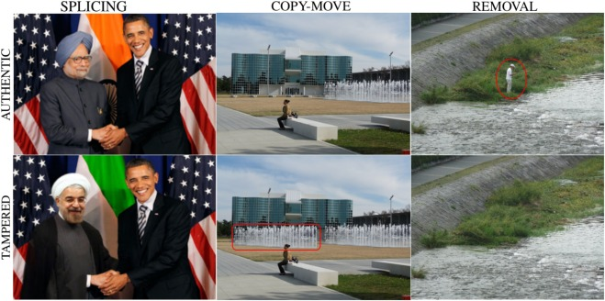
Introduction
Importance of images in the digital era: Used for communication, documentation, and entertainment.
Concerns about image authenticity and integrity due to powerful image editing tools.
Image forgery: Manipulating or altering images to deceive viewers.

Slide 4

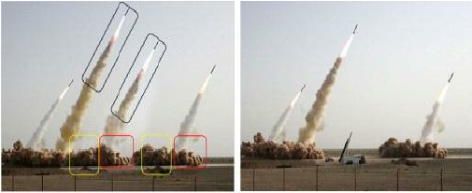
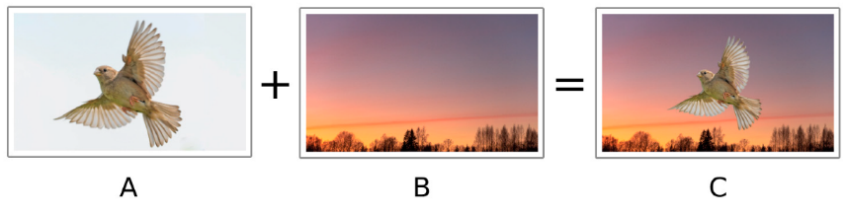
Types of forgery
Copy-move forgery: Portion of an image is copied and pasted to conceal or duplicate objects.
Splicing forgery: Distinct parts of multiple images combined to create a composite image.
Copy move forgery
Splicing forgery

Slide 5
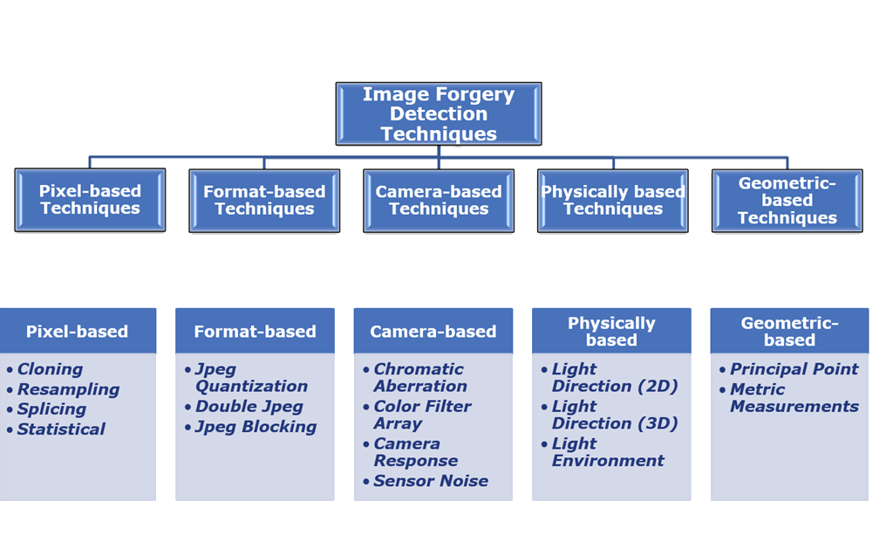
Types of forgery detection
Image forgery detection is split into different techniques:
Pixel based
Format based
Camera based
Physical based
Geometry based
In this project for phase one and two we focus on pixel-based techniques.

Slide 6

Using machine learning and deep learning for image forgery detection
Machine learning and deep learning involve developing algorithms that can learn from data and make predictions without explicit programming.
Requires large and diverse datasets of authentic and manipulated images.

Slide 7
Using machine learning for image forgery detection
Pre- processing
(color space conversion,
normalization)
Feature extraction
(DCT,LBP,DWT)
Classification
(SVM, Decision tree, Random forest )
Post- processing
Step 1
Step 2
Step 3
Step 4
Combined step in Deep learning

Slide 8

The Approach for Deep Learning image Forgery Detection
Deep learning models (ResNet-50, InceptionV3) trained to extract features and classify images.

Slide 9
Previous work: machine learning
Paper Title | Type of Forgery Detected | Dataset Used | Method Used | Accuracy Achieved
A. Doegar et al. (2020) | Splicing and Copy-Move | MICC-F220 | Random Forest | 89.55%
Mandeep et al. (2016) | Splicing | Casia1, Casia2, Colombia | LBP-DCT to SVM | 97%
M. M. Islam et al. (2020) | Splicing and Copy-Move | Colombia grey, Colombia color, CASIA1, CASIA2, and FBDDF | DCT- LBP to SVM | For gray scale images: Columbia Gray: 85.56% Columbia Color: 96.10% CASIA 1: 98.61% CASIA 2: 99.29%FBDDF: 95.84% For color images: Columbia Gray: 98.20% Columbia Color: 99.55% CASIA 1: 99.88% CASIA 2: 100.00%

Slide 10
Previous work: deep learning
Paper Title | Type of Forgery Detected | Dataset Used | Method used | Accuracy Achieved
Zhang et al. (2016) | Splicing and Copy-Move | CASIA | Stacked Autoencoder (SAE) | 91.09%
Abhishek & Jindal (2020) | Copy-Move and Splicing | GRIP, DVMM, CMFD, BSDS300 | deep convolution neural network and semantic segmentation | Above 98%
S. Nath and R. Naskar (2021) | Image Splicing | Casia 2.0 | CNN and ANN | Experiment 1: 96.45%, Experiment 2: 92.08%
F.M. Al_Azrak et al. (2020) | Copy-Move and Splicing | MICC-F220 | CNN | Method 1: 85%, Method 2: 100%
Agarwal. R et al. (2020) | Copy-Move | MICC-F220 | Simple Linear Iterative Clustering And VGGNet | 95%
Hao. J et al. (2021) | Copy-Move and Splicing | Casia, Coverage, IMD2020 | Fully Convolutional Network (FCN) and self-attention encoders | 88%

Slide 11

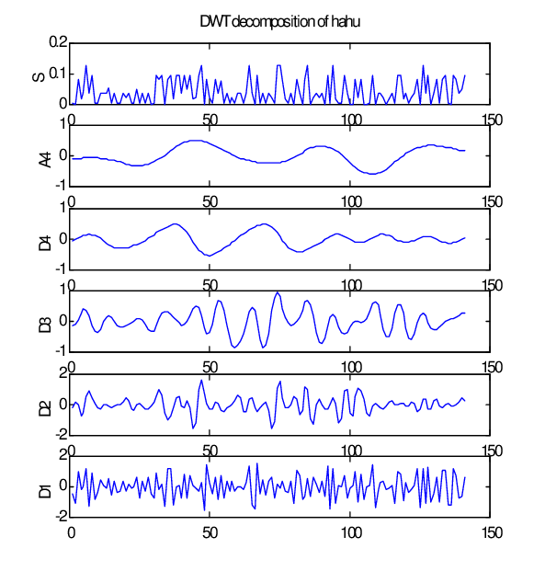
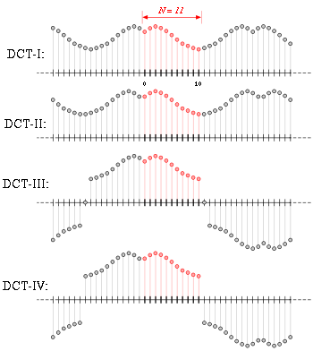
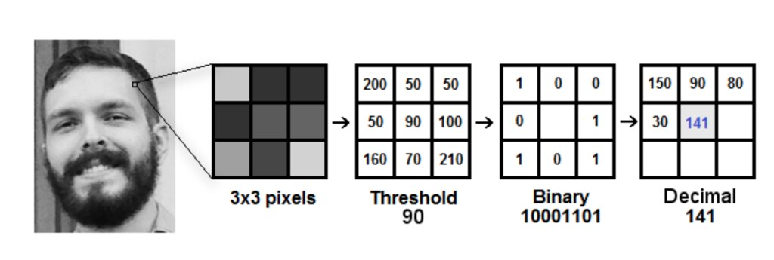
Image Forgery Detection Techniques Using Machine Learning
Feature extraction methods: Local Binary Patterns (LBP), Discrete Cosine Transform (DCT), Discrete Wavelet Transform (DWT).
Feature Extraction: LBP encodes texture information, while DCT or DWT captures frequency components or sub-bands.
Classifiers such as SVM , Random Forest or Decision Tree.

Slide 12

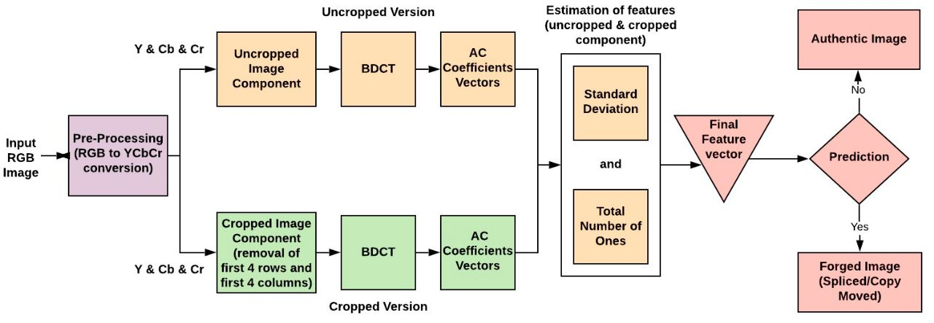

Project methodology: Machine learning
(SVM)
Image forgery detection using dct statistical coefficients. S.Dua et.al (2020).

Slide 13
Considerations for dataset choice
Success depends on diverse and well-labeled datasets.
Datasets should cover variations in size, rotation, scaling, and content.
Data augmentation techniques (e.g., random cropping, flipping, rotation) enhance model robustness and generalization.

Slide 14

Evaluation Datasets for machine learning - CASIA v1.0 and v2.0
CASIA v1.0 dataset:
1721 images.
800 authentic images, 921 tampered color images.
Size: 384x256 pixels, JPEG format.
CASIA v2.0 dataset:
Multiple sized images.
7491 authentic images, 5123 forged color images.
Size varies from 240x160 to 900x600 pixels.
Available in uncompressed and JPEG formats with different quality factors.
Colombia uncompressed dataset:
183 images
The image sizes range from 757x568 to 1152x768 and are uncompressed

Slide 15

RESULTS
Performance Evaluation Metrics:
Accuracy. (Percentage of correct predictions)
Results:
98% accuracy on a relatively small dataset.

Slide 16
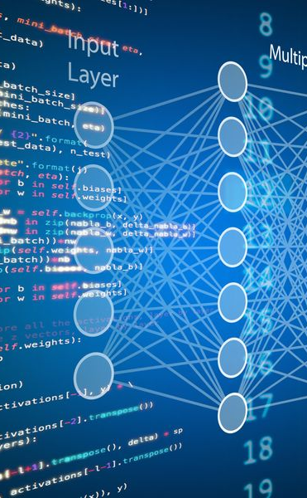
Project methodology: Deep learning
Experimenting with multiple models to find the best accuracy
ResNet50 was used for splicing detection.
InceptionV3 was used for copy-move detection.

Slide 17
Models and Accuracy Comparison
Models used in trial for splicing and copy move detection:
Regular CNN deep learning methods, EffnetB0 – B7, ResNet152, DenseNet.
Final models selected: ResNet50 for splicing and InceptionV3 for copy move detection.
Comparison of methods used for splicing detection:
Method used | accuracy | dataset
SVGGNet | 84% | CasiaV2
CNN | 59% | CasiaV2
ResNet50
EffNetB4 | 48% | CasiaV2
EffNetB5 | 81% | CASIA 1&2 +Colombia + MICCF2000 + IMD 2020 + DeFacto splicing
EffNetB7 | 70% | CasiaV2
Method used | accuracy | dataset
DenseNet | 53% | Defacto Copy Move
ResNet50 | 75% | Defacto Copy Move
ResNet152 | 86% | Defacto Copy Move
Inception V3 | 90% | Defacto Copy Move
EffNetB0 | 70% | Defacto Copy Move
Method used | accuracy | dataset
DenseNet | 50% | Defacto Splicing
ResNet50 | 93% | Defacto Splicing
ResNet152 | 62% | Defacto Splicing
Splicing and copy move
Copy-Move
Splicing

Slide 18

InceptionV3 for copy move detection
InceptionV3: Convolutional neural network (CNN) architecture made by Google researchers.
"Inception" refers to the use of inception modules with parallel convolutional layers of varying sizes.
InceptionV3 improves on previous versions with enhancements for performance and accuracy.
Trained on Imagenet Dataset.

Slide 19
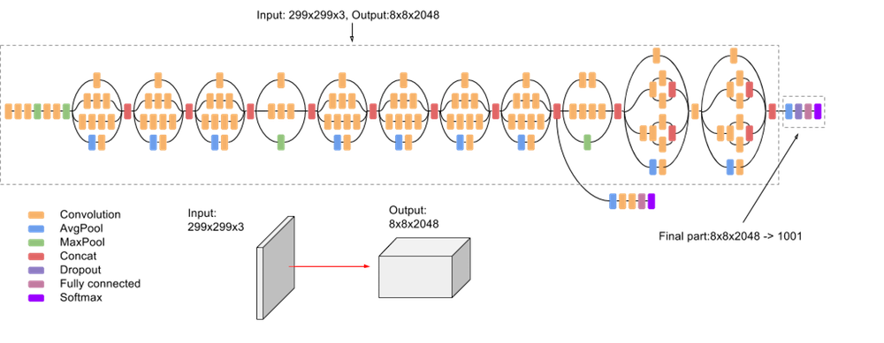
InceptionV3 for copy move detection
Factorization or bottleneck layers.
Auxiliary classifiers in intermediate layers to address vanishing gradient problem.
Convolutional layers, pooling layers, and fully connected layers.

Slide 20
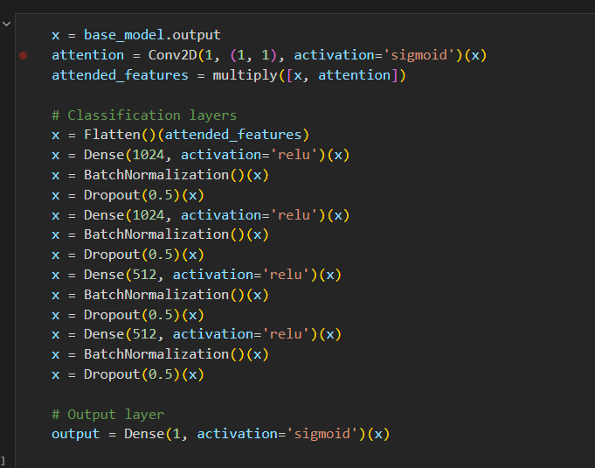
Additional Layers for Improved Classification
Attention is applied using a convolutional layer with a small kernel size, which calculates attention weights for different features.
Attention weights are multiplied element-wise with the original features in x, resulting in attended features.
Attended features are flattened into a 1-dimensional vector and passed through a series of dense layers.
Dense layers use ReLU activation function, batch normalization and dropout.
The output layer consists of a single unit with a sigmoid activation function, producing a value between 0 and 1 that represents a probability.

Slide 21
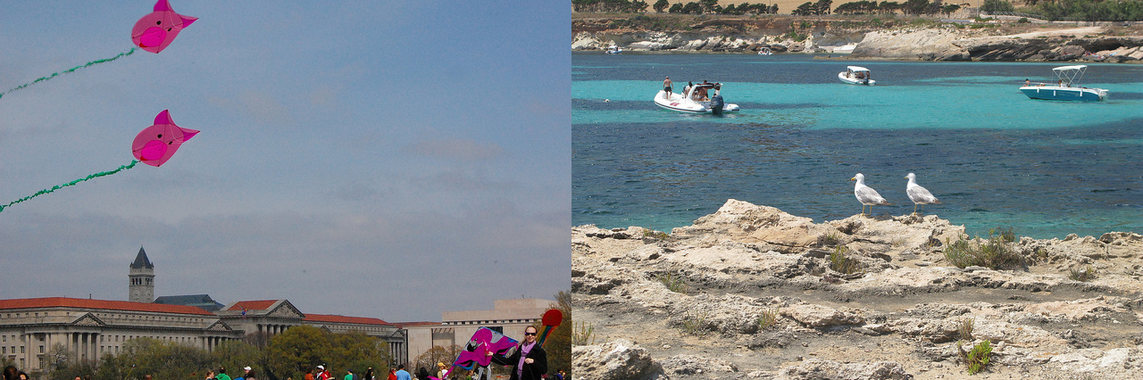
Datasets used for training deep learning models
The dataset is called Defacto copy move, it is based on MSCOCO and is available to download on Kaggle.
The dataset consists of 18,000 copy move images.
18,000 authentic images from COCO2014 were added to balance out the dataset.
Defacto copy move

Slide 22
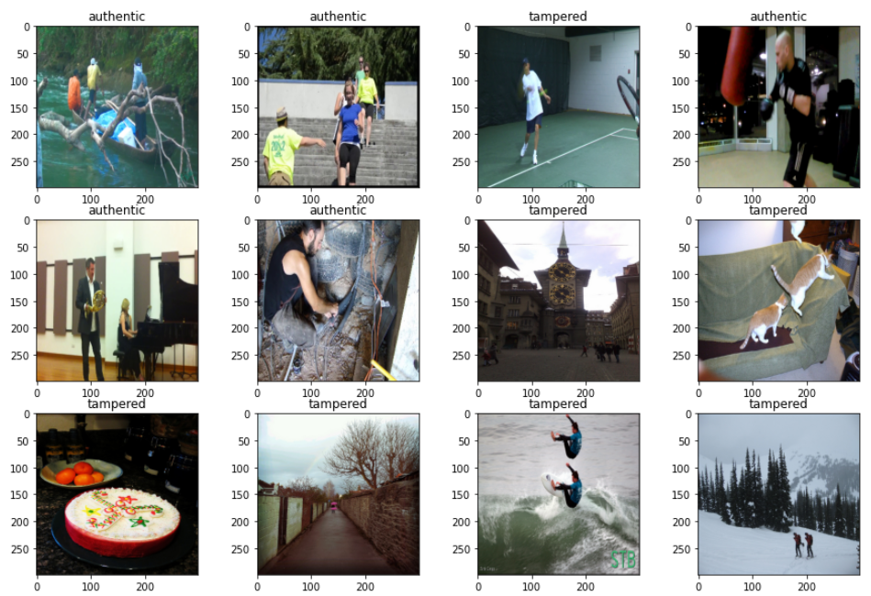
Deep Learning Copy move detection results
Utilized InceptionV3 with additional layers.
Train-test-validation split: 80% training, 10% testing, 10% validation.
Achieved accuracy of 90%.
Training conducted on Linux Ubuntu with GPU acceleration.

Slide 23

ResNet-50 for Splicing image Forgery Detection
ResNet-50: Deep convolutional neural network (CNN) architecture.
Widely used for computer vision tasks, including splicing image forgery detection.
Deep structure enables learning of intricate patterns and features.
Residual connections mitigate vanishing gradient problem in deep networks.

Slide 24
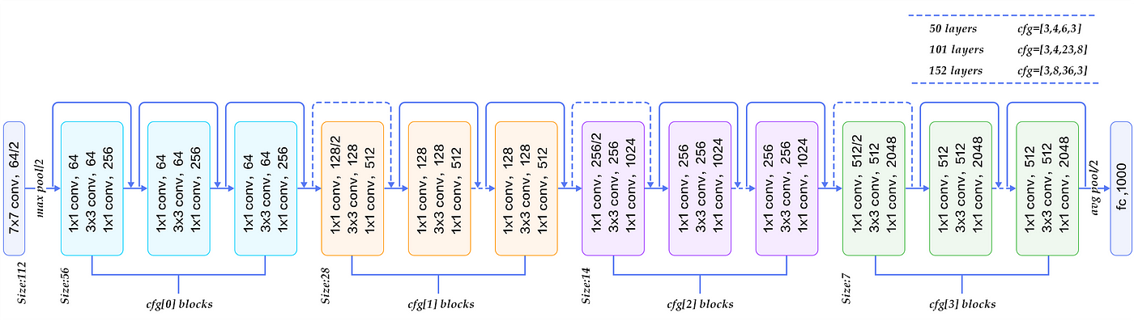
Key Components of ResNet-50
Input Layer: Accepts fixed-sized tensor of image data.
Convolutional Layers: Extract low-level and high-level features.
Residual Blocks: Enable deeper learning by propagating gradient information effectively.
Pooling Layers: Reduce spatial dimensions while retaining important information.
Fully Connected Layers: Learn high-level representations and transform feature maps.
Output Layer: Classifies between authentic and spliced images.

Slide 25
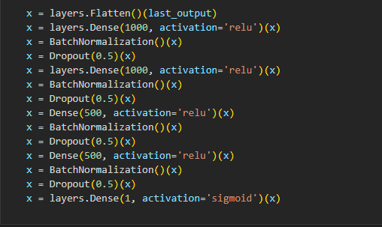
Additional Layers for Improved Classification
Flatten Layer: Reshapes output from previous layer into a 1-dimensional vector.
Dense Layers with ReLU Activation.
Batch Normalization Layers: Normalize activations for stable training and efficient optimization.
Dropout Layers: Prevent overfitting by randomly setting units to 0 during training.
Final Dense Layer with Sigmoid Activation: Value between 0 and 1 that represents a probability.

Slide 26
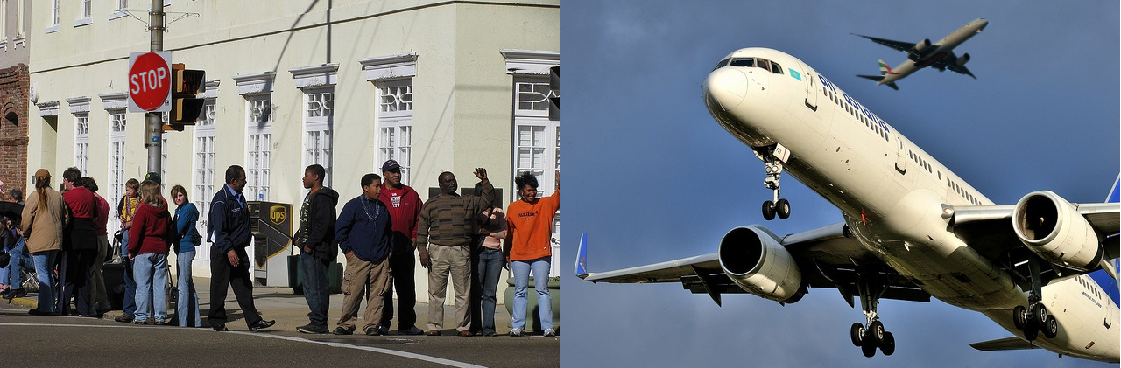
Datasets used for training deep learning models
The dataset is called Defacto splicing, it is based on MSCOCO and is available to download on Kaggle.
The dataset consists 100,000 spliced images.
100,000 Authentic images from COCO2014 were added to balance out the dataset.
Defacto splicing

Slide 27
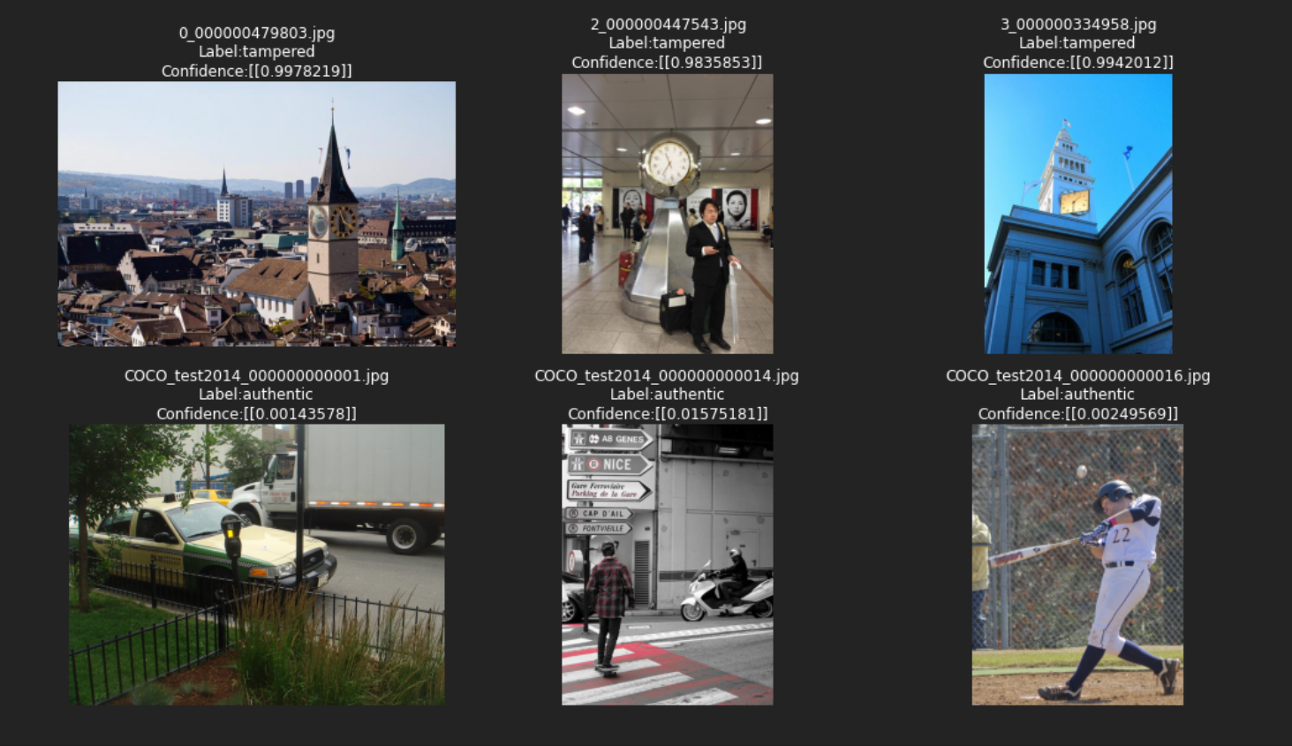
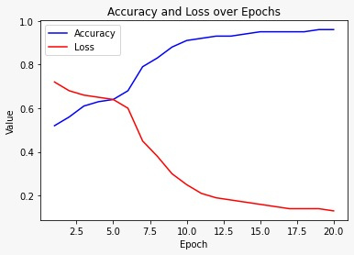
Deep Learning Splicing Detection
Utilized ResNet50 with additional layers.
Train test validation split: 80% training, 10% testing, 10% validation.
Achieved accuracy of 93%
Training conducted on Linux Ubuntu with GPU acceleration.

Slide 28
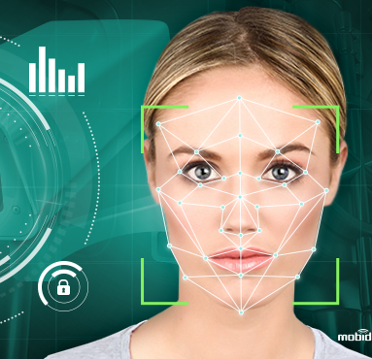
Deep Learning for AI-Generated Face Detection
AI-generated faces are synthetic human-like images created using AI algorithms such as (Style GAN, Stable Diffusion, Midjourney).
Detection helps mitigate potential misuse and unethical practices associated with AI-generated content.

Slide 29
Other modEls tested
Model | Accuracy
ResNet50 | 52%
InceptionV3 | 57%

Slide 30
DenseNet for AI-Generated Face Detection
DenseNet:
Deep learning architecture effective in computer vision tasks.
Addresses vanishing gradient problem.
Unique connectivity pattern promotes feature reuse and information flow.
Using DenseNet for AI-generated face detection:
Transfer learning: DenseNet model used as feature extractor.
Fine-tuning on labeled dataset of real and AI-generated faces.
Dense connectivity captures subtle differences in facial features.

Slide 31
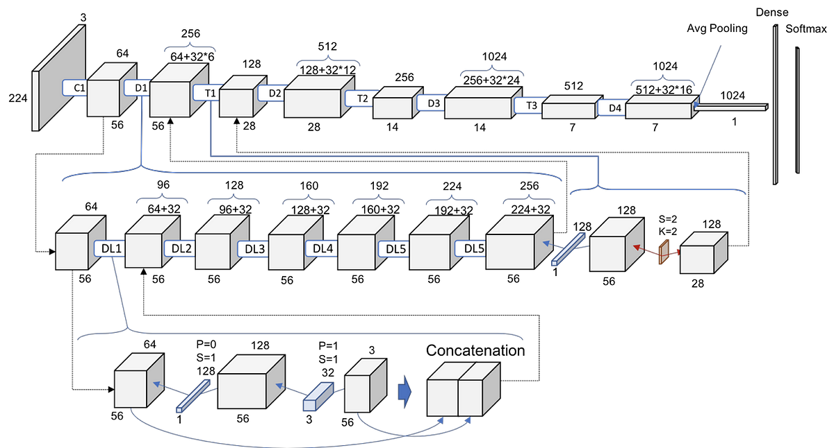
DenseNet Architecture
Consists of densely connected blocks of convolutional layers.
Each block receives feature maps from all preceding layers.
Promotes information flow and learns discriminative features from different scales and levels of abstraction.
Initial layers serve as feature extractor, capturing generic facial features.
Last few layers modified for classification (real or AI-generated).

Slide 32
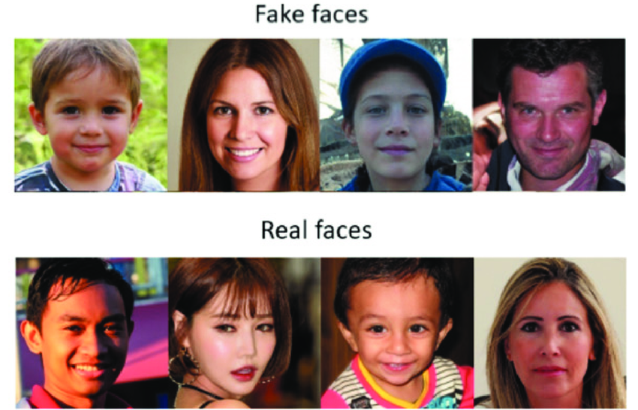
Dataset Used for AI generates image: 140k Real and Fake Faces
Dataset designed for facial image analysis, computer vision, and deep learning.
Contains 140,000 samples of real and fake faces.
Synthetic faces are generated by StyleGAN

Slide 33
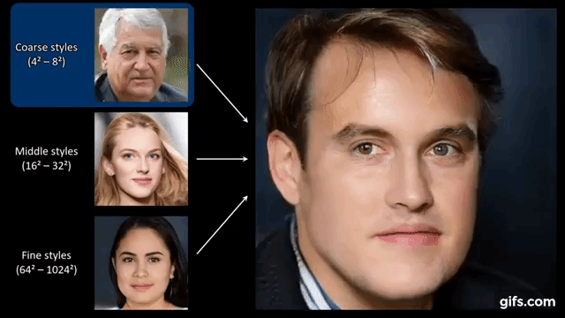
Style-GAN Overview
StyleGAN:
Deep learning Generative Adversarial Network architecture for generating realistic human faces.

Slide 34
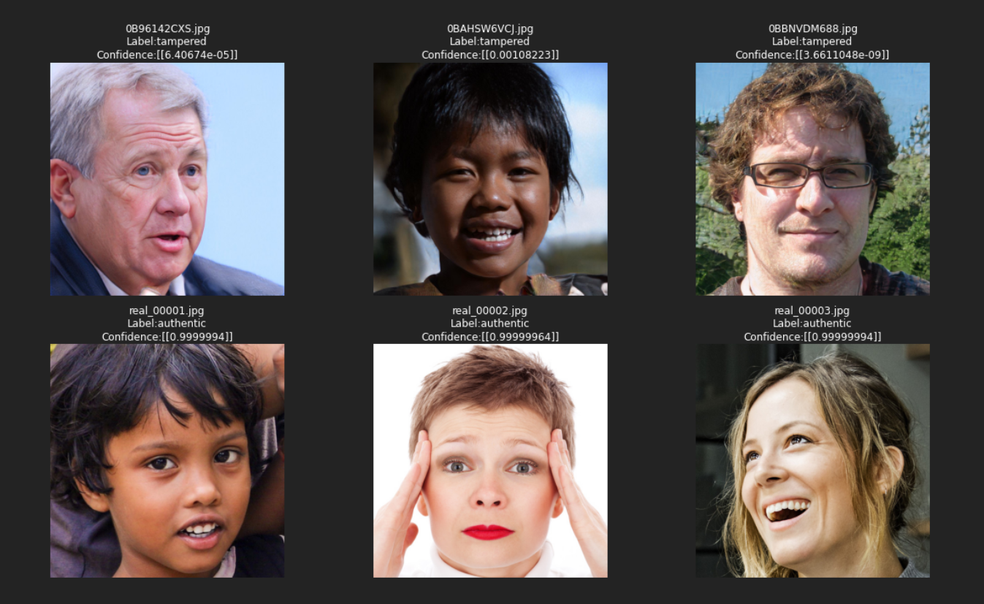
StyleGAN AI Generated faces detection results
Utilized Densenet
Train-test-validation split: 80% training, 10% testing, 10% validation.
Achieved accuracy of 98%.
Training conducted on Kaggle with GPU p100 acceleration

Slide 35
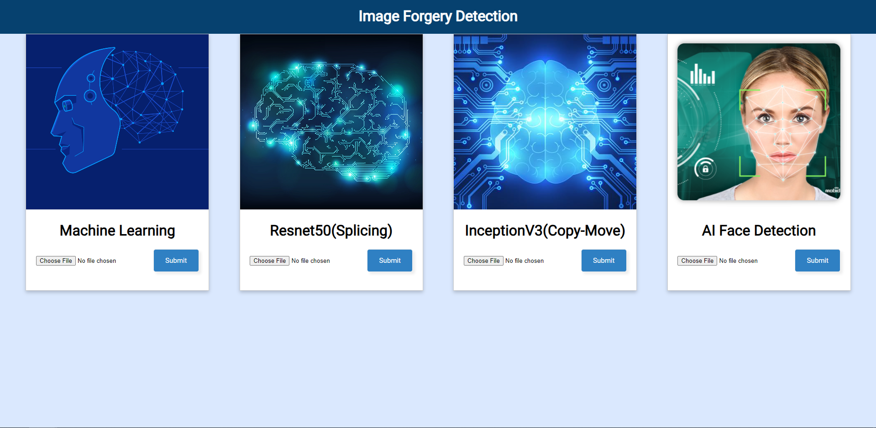
Web Application Architecture
Developed using HTML, CSS, and Flask.
User interface offers all the model we created so far.
Allows user to select an image and receive a result (forged or authentic).
Flask chosen for ease of communication with models and running them on the server.
CSS utilizes Flexbox for responsive design on different screen sizes.

Slide 36
Conclusion
Focused on detection of splicing and copy move image forgeries using machine learning and deep learning models.
Traditional machine learning techniques, such as DCT and SVM, achieved 98% accuracy in forgery detection on a smaller dataset.
ResNet50 achieved 93% accuracy in splicing detection.
InceptionV3 achieved 90% accuracy in copy move detection.
DenseNet achieved 98% accuracy in AI-generated face detection from StyleGAN.
Integrated detection models into a user-friendly website for easy image upload and feedback.

Slide 37
Future work
Tampering localization:
Localize the specific area of tampering in the image and output it to the user.
Detecting AI generated images more generally:
Building a model that can generalize on the modern generative models.
Building a faster website:
Hosting the website on faster servers so the models can predict faster.

Slide 38
Thanks!

